Slide 1
Unit 3 Numbers
数字

Slide 2
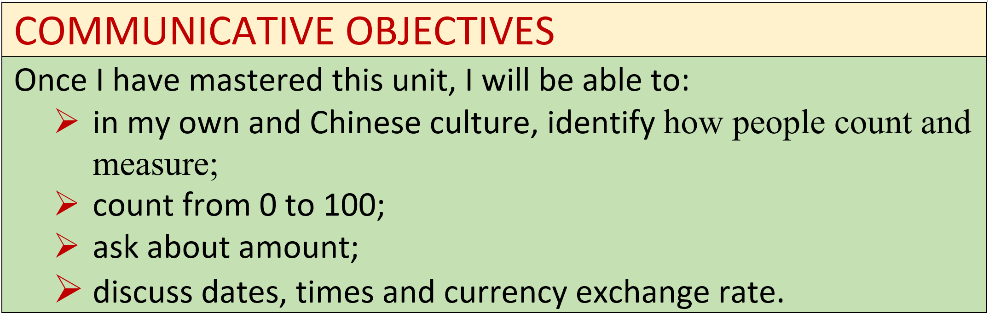

Slide 3
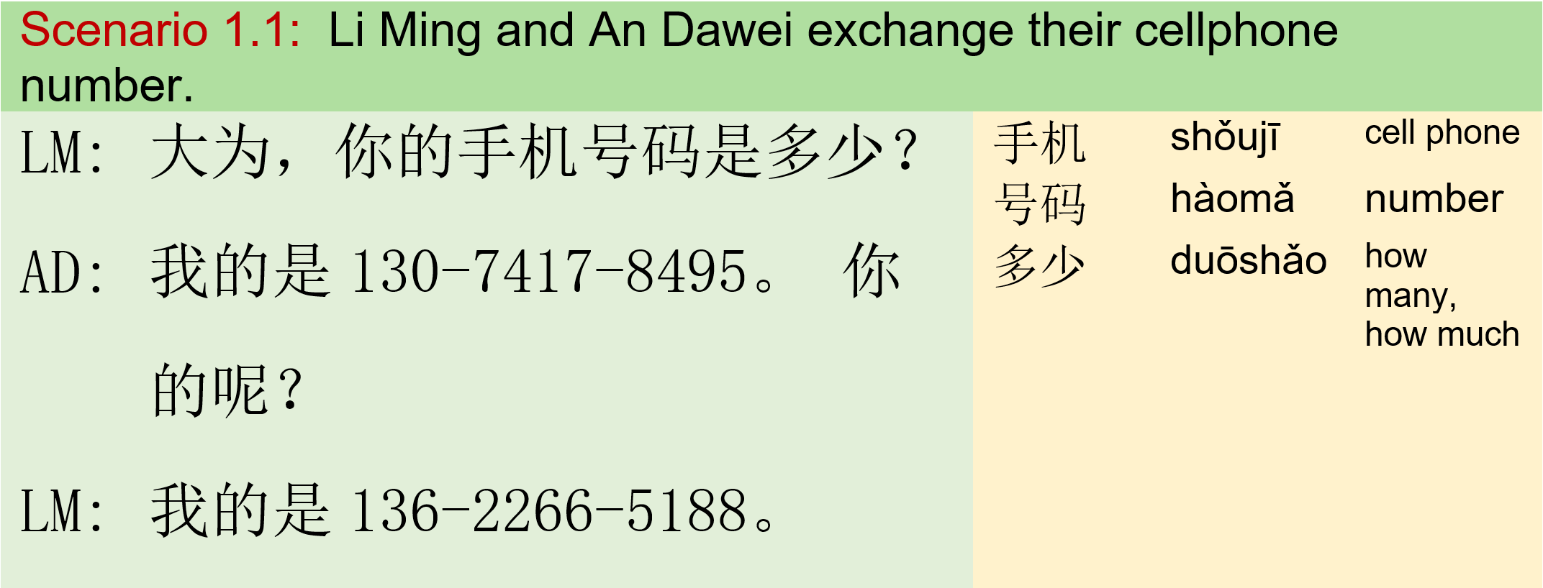

Module I : Numbers 模块一：数字

Slide 4
Exercise
Communication:
Students ask each other the phone number At lease ask 3 different people
Question word: 多少
Q: 你的电话号码是多少？
A: 我的是13074178494。

Slide 5
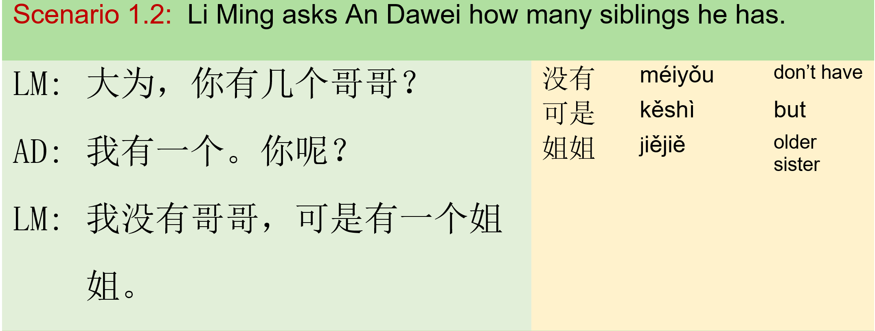
Module I : Numbers 模块一：数字

Slide 6
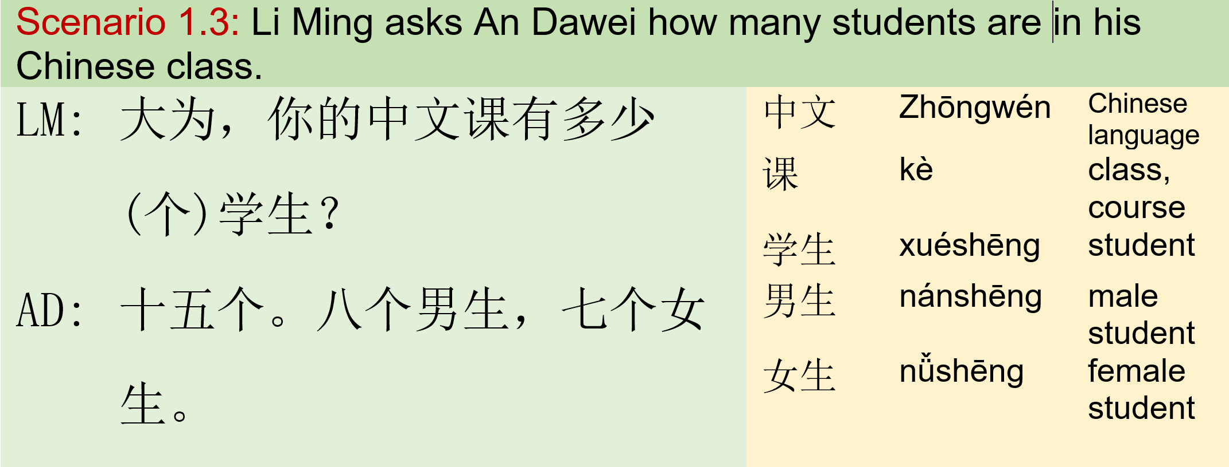
Module I : Numbers 模块一：数字

Slide 7
Exercise
Communication:
Students pair up; Do substitute drills. Note: 没有 means ‘don’t have’
Question word: 多少/几+MW
 |  | 猫
 |  | 狗
你有几个 | + | 名字
你有多少个 |  | 学生
 |  | 孩子
 |  | Nouns

Slide 8
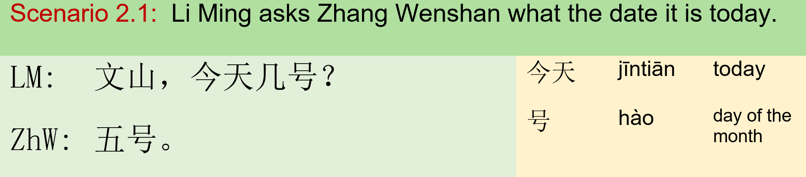
Module II: Dates 模块二：日期

Slide 9
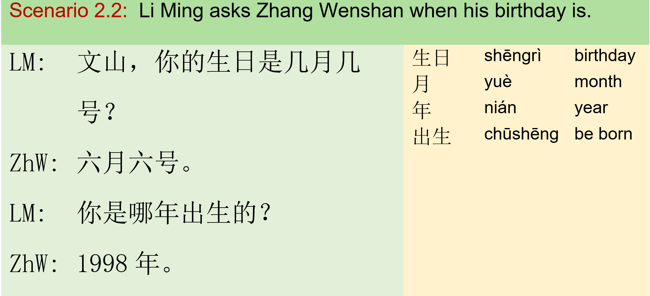
Module II: Dates 模块二：日期

Slide 10
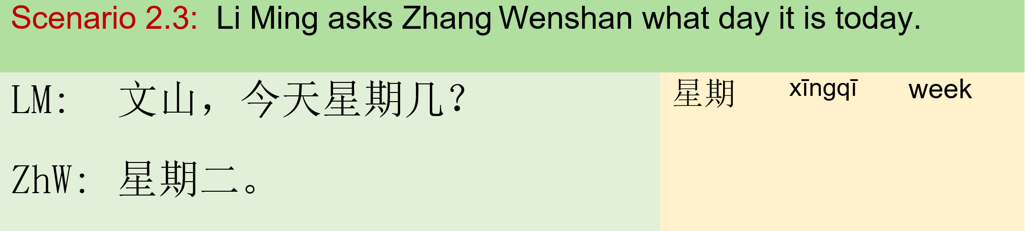
Module II: Dates 模块二：日期

Slide 11
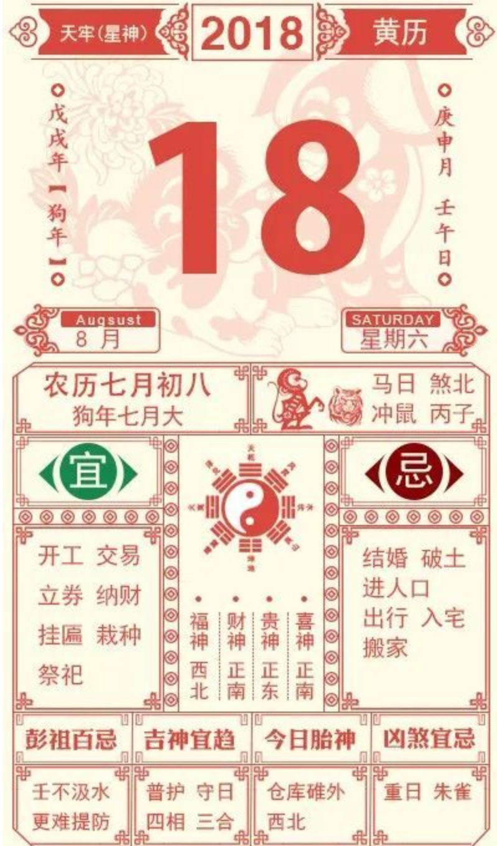
Exercise
Communication:
Students read the calendar aloud 中华万年历

Slide 12
Exercise
Communication:
Students conduct a survey to find out: Who is the youngest in the class? Who is the oldest in the class? Who was born in September? Who was born on 13th? Steps: Students pair up Create survey questions Collect datas Orally report

Slide 13
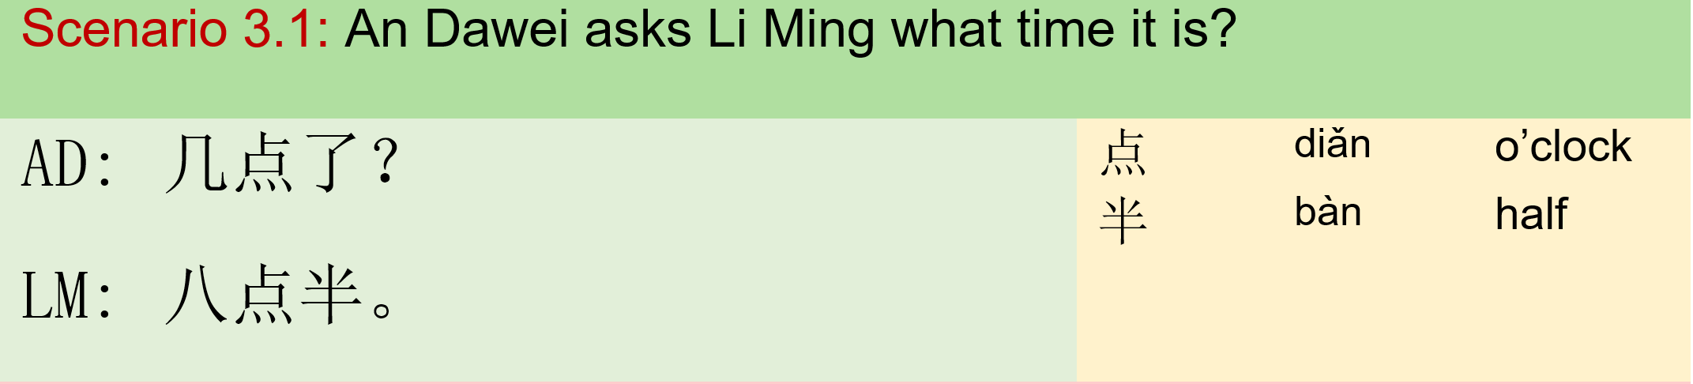
Module III: Time of Clock 模块三：时间

Slide 14
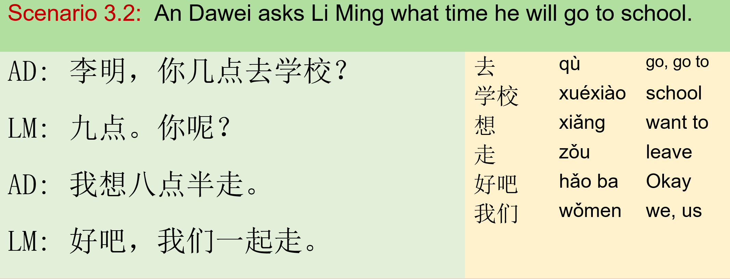
Module III: Time of Clock 模块三：时间

Slide 15
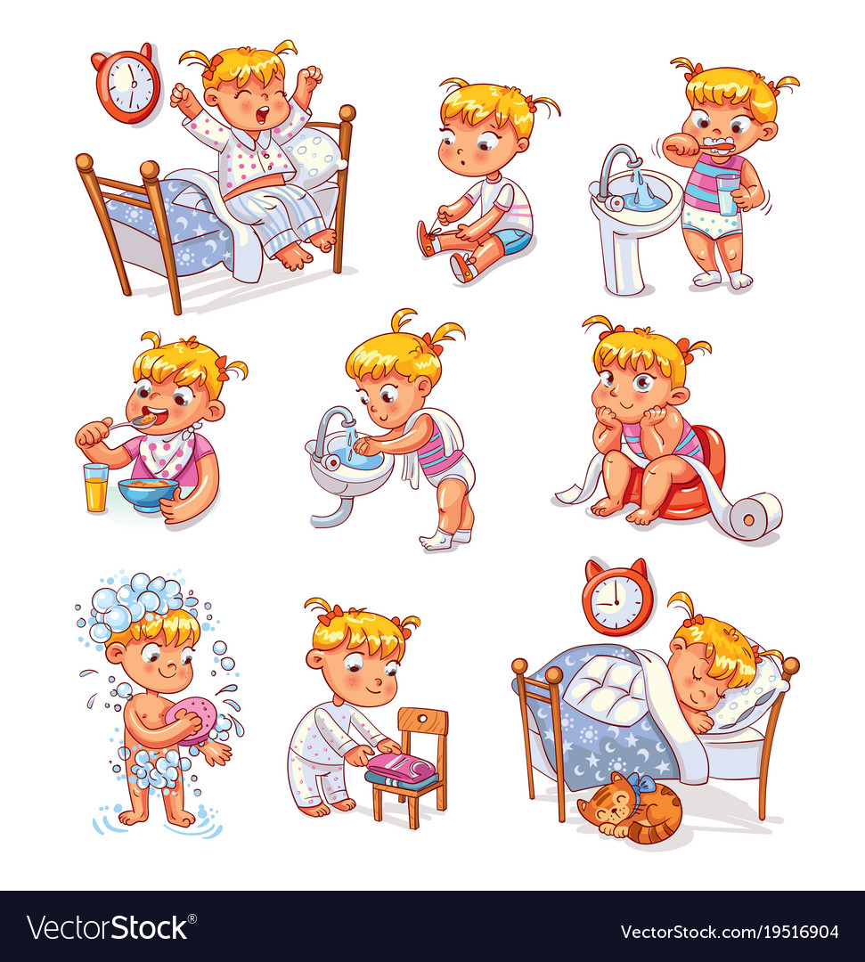
Exercise
Communication:
Students play game 老狼，几点了？ Students read time of clock aloud; Student use 你几点…? to talk about the picture on the left.

Slide 16
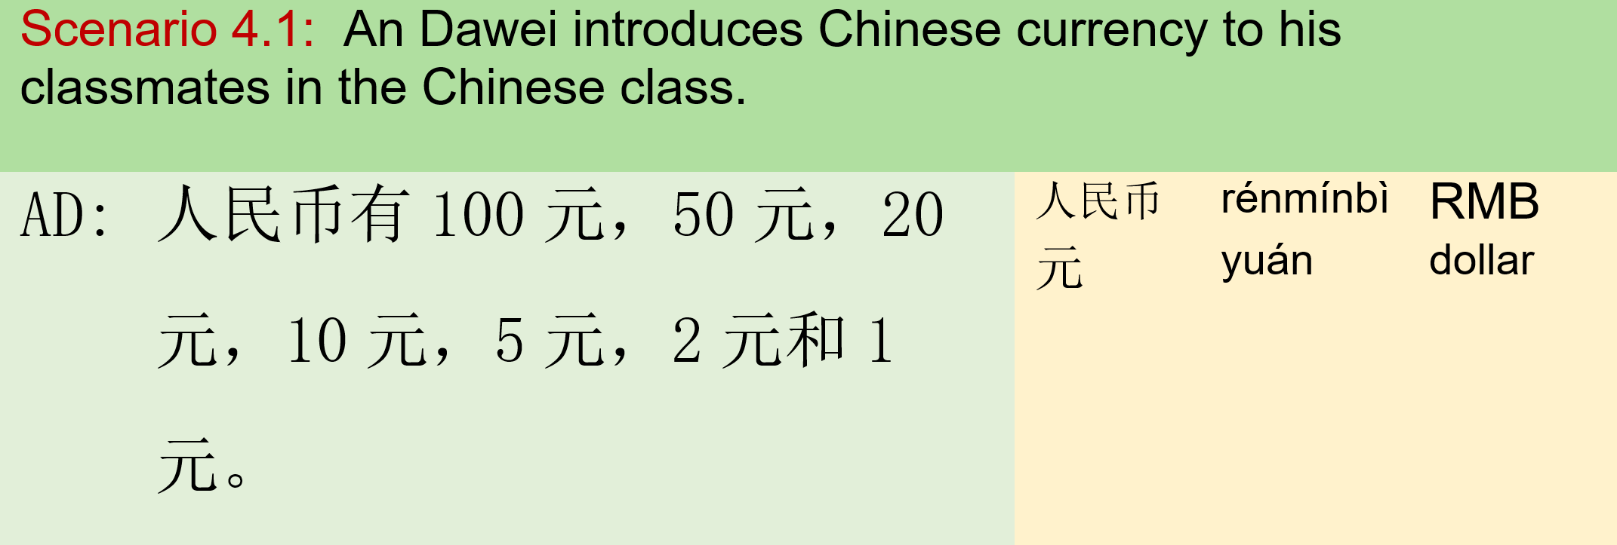
Module IV: Currency 模块四：货币

Slide 17
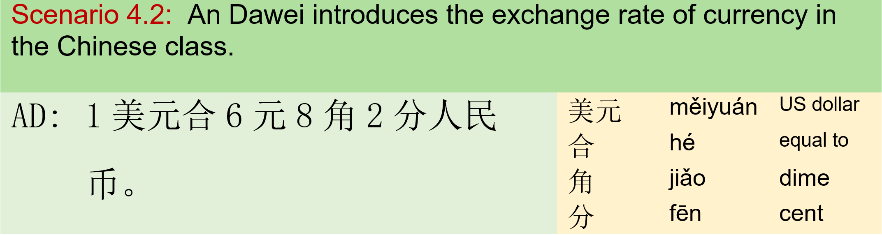
Module IV: Currency 模块四：货币

Slide 18

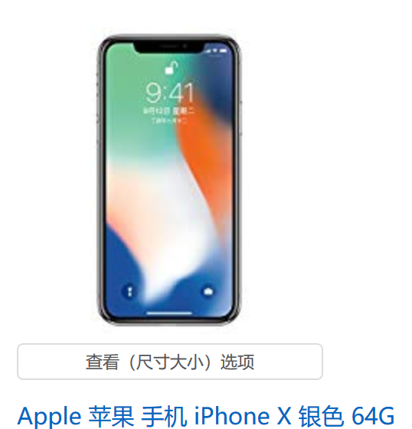
Exercise
Communication:
- Students find the price of these items on https://www.amazon.cn/ and fill in blanks - Orally report
RMB
USD

